Slide 1
Two applications for the last manuscript (device lifetime maximization)
Precision salmon System
Emergency communication

Slide 2
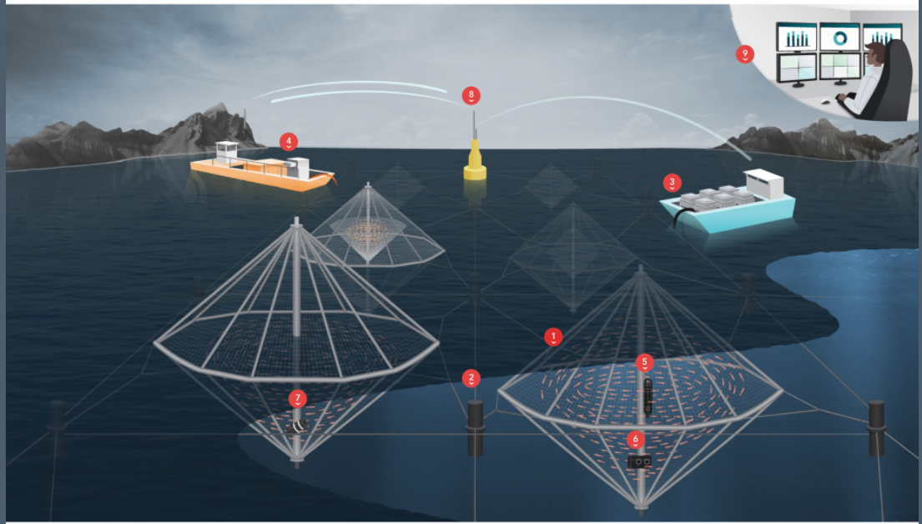
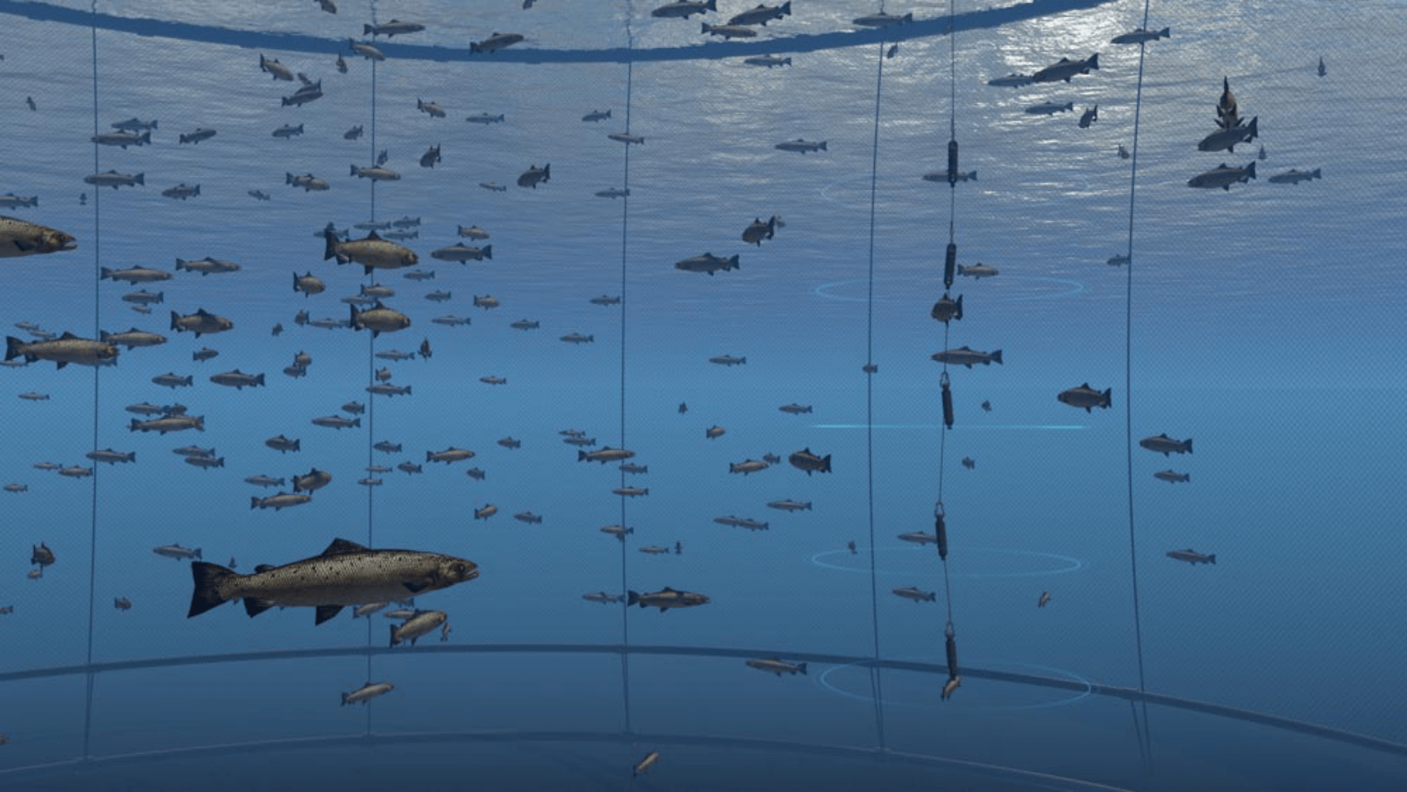
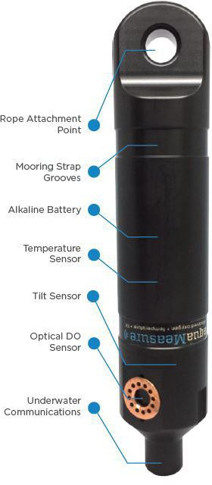
Precision salmon System
sensors were installed to collect information determining the vertical distribution of the fish in the cage, while a network of environmental sensors characterized local site conditions.
Fish response based on thermoregulation (temperature variations), oxygen levels, or weather data can be used to inform feeding schedule, oxygen supplementation, or stocking densities to ensure fish health.
aquaMeasure sensors
https://www.innovasea.com/open-ocean-aquaculture/
Notes:
Schematic of sensor configuration within a cage

Slide 3
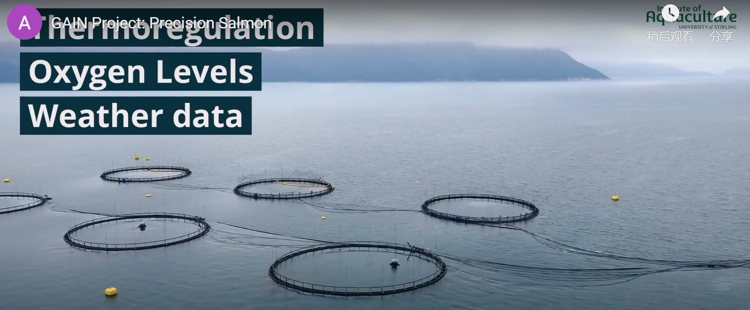
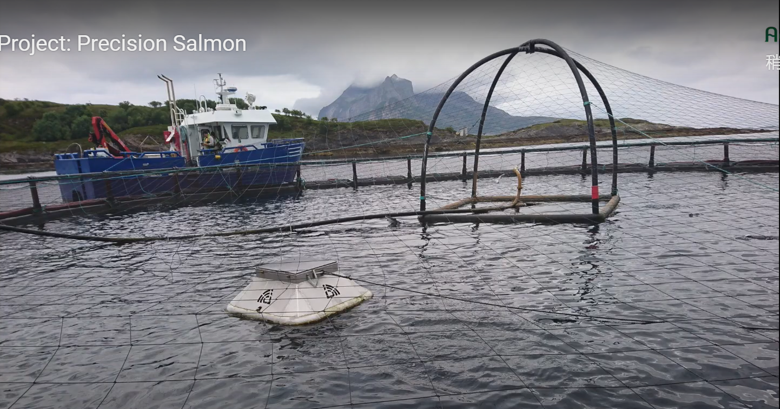
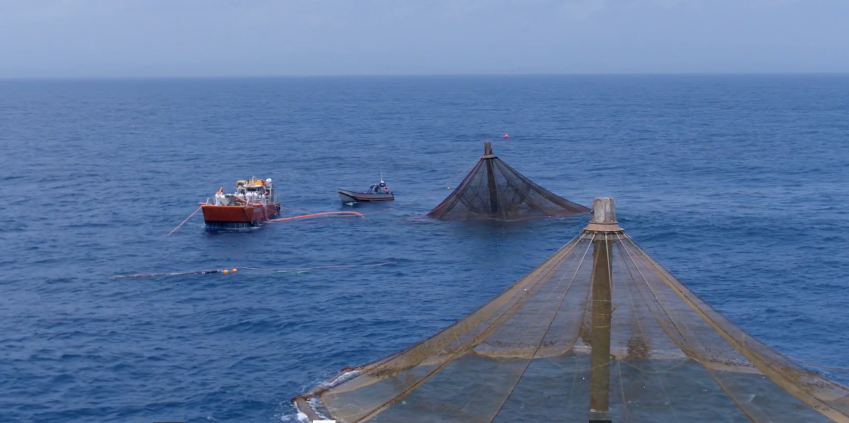

Slide 4
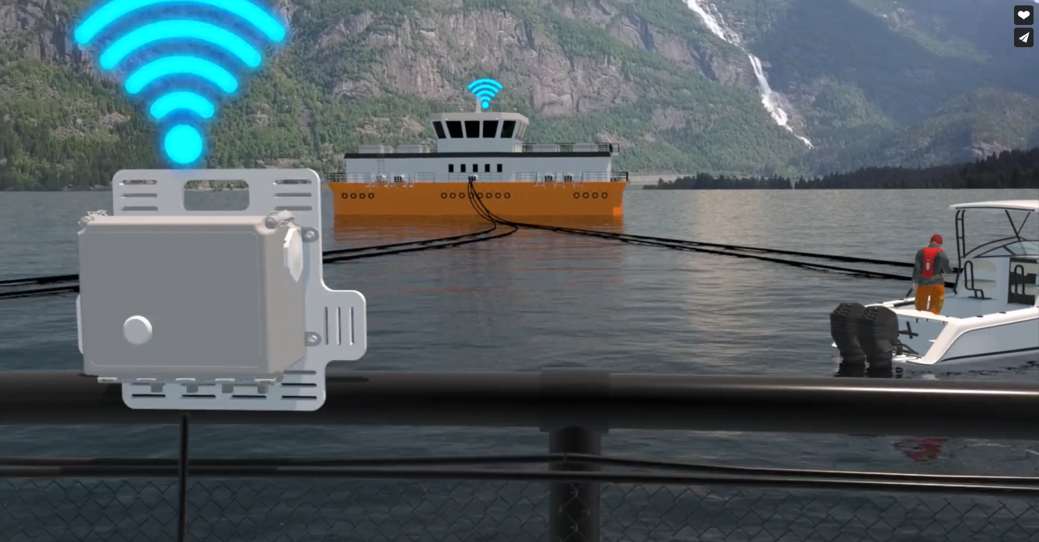
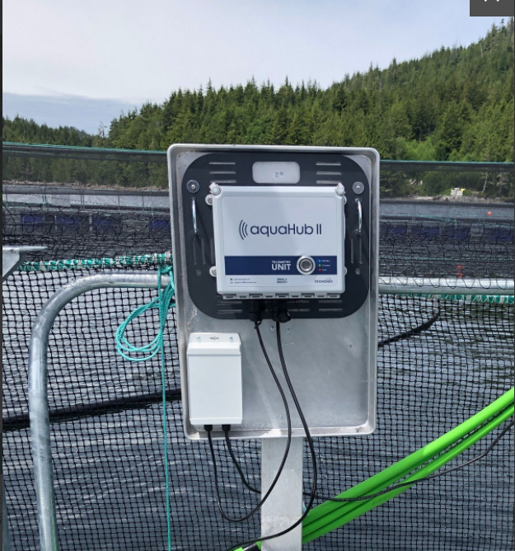
Secure Cloud Communications for Aquaculture
All the information from aquaMeasure sensors is sent to the aquaHub, which can be mounted on existing infrastructure or on a feed barge.
Roughly the size of a shoebox, the aquaHub uploads the data to the cloud via cellular, Wi-Fi or Iridium satellite
Replaced by UAV in remote area

Slide 5


Emergency communication
An example
In World War II, expendable sonobuoy was dropped into the ocean in response to the devastating destruction of shipping in the Atlantic caused by U-boats.
https://apps.dtic.mil/dtic/tr/fulltext/u2/a597432.pdf

Slide 7
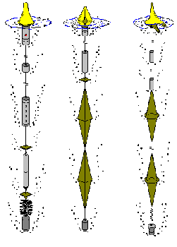
The Directional Command Activated Sonobuoy System (DICASS) sonobuoy is an active acoustic sonobuoy used by the Navy to detect submarines.
Operate for up to one hour at depths of up to 457 m (1,500 ft).
The echo returns of the active sonar signals provide range, bearing, and Doppler information on acoustic contacts
https://dosits.org/galleries/technology-gallery/locating-objects-by-listening-to-their-sounds/difar/
Notes:
The Directional Command Activated Sonobuoy System (DICASS) sonobuoy is an active acoustic sonobuoy used by the Navy to detect submarines. The “command activated” part of the system allows DICASS buoys to receive radio transmissions instructing the buoy to change depth, activate sonar transmissions, or scuttle itself. Active sonar pulses can be transmitted at four frequencies (6.5 kHz, 7.5 kHz, 8.5 kHz, and 9.5 kHz) and can operate for up to one hour at depths of up to 457 m (1,500 ft). The echo returns of the active sonar signals provide range, bearing, and Doppler information on acoustic contacts

